Slide 1
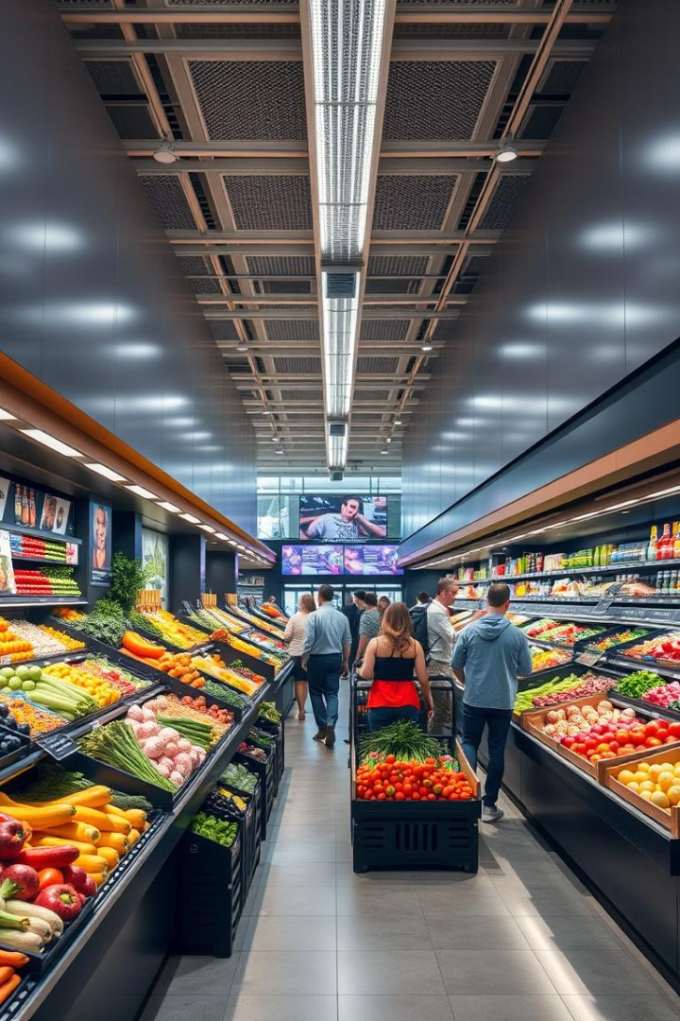
Interactive Supermarket Sales Dashboard: Internship Task 3
This project involves creating an interactive dashboard to analyze supermarket sales data. It highlights key sales metrics and supports data-driven decisions. The dashboard offers powerful insights into sales patterns and customer behavior.
gs
by Himanshu Kushwaha

Slide 2

Data Acquisition and Preparation
Data Sources
Cleaning
Used supermarket sales data from public datasets Kaggle.
Handled missing values and removed outliers for accuracy.
Feature Engineering
Tools
Created new metrics, such as profit margin, to enrich analysis.
Power Bi is used for creating the Sales dashboard.

Slide 3
Dashboard Design and Structure
Tools Used
Key Metrics
Visualizations
Design
In this I use the Data visualization tool Power Bi and for data cleaning excel
Is used
Total sales
Bar graph is use for outlet
Percentage and MRP
Focused on intuitive layout with profession theme little
darker
Profit
Units sold
Donut chart for the item
percentage
Customer counts
Matrix is use for tracking
overall Sales all over the
year

Slide 4
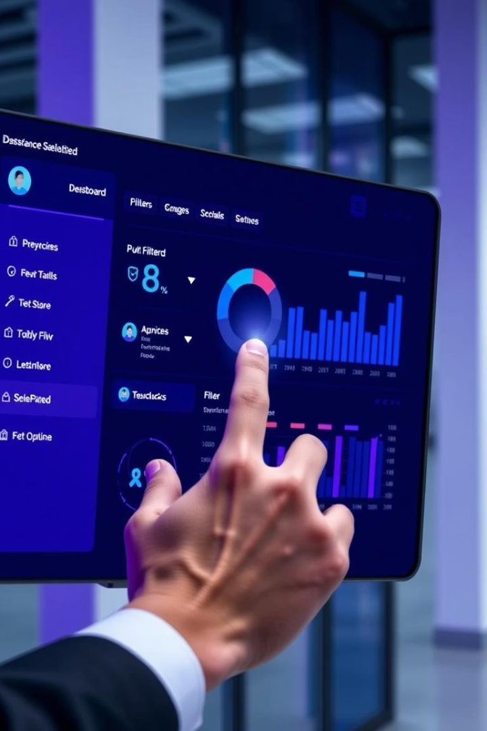




Interactive Elements
Filters
Select date ranges, product categories, and store locations.
Drill-downs
Explore sales quickly from summary to detailed views.
Tooltips
Hover for additional context and data explanations.
Cross-filtering
Highlight relationships between data across categories.

Slide 5





Sales Performance Analysis & Insights
Top Products
Sales Trends
2
Snack food items are the top product sell with the sale of 1.5 Million .
The Total price of the item in the supermarket come 801.15K
1
3
Tier Performance
Outlets
5
The total sum of the outlet is 11Millions
The Tier 3 product are at the high sale with 315.44K and 4.45 Million outlets
4

Slide 6

Conclusion & Future Improvements
Summary
Dashboard reveals crucial sales insights for informed decisions.
Benefit
Empowers stakeholders to optimize sales and marketing efforts.
Future
Plan to add predictive analytics and integrate real-time data.
Thank You
Appreciate your attention – open for questions.

